Slide 1
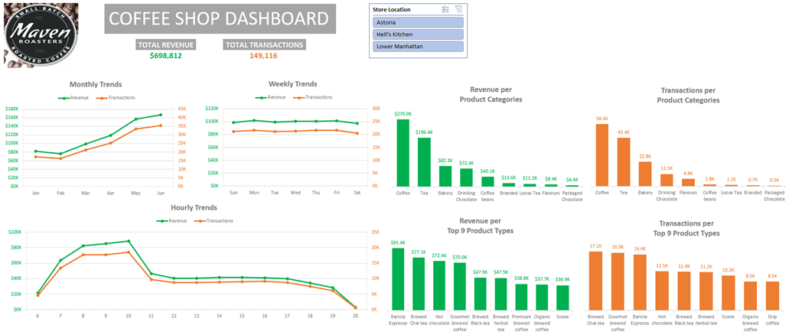

Slide 2
Abstract
I conducted a product sales analysis of a fictional coffee shop called Maven Roasters.
My analysis focused primarily on the revenue and transactions generated by the coffee shop throughout its day-to-day operations.
Since there is no data about the coffee shop’s expenses, the scope of my analysis did not include any profit maximization strategies.
I used Microsoft Excel to conduct my analysis.
I cleaned the data and added calculated fields using Power Query.
I used Pivot Tables to aggregate the data.
I used Pivot Charts to create a dashboard that summarizes the following information:
Monthly, Weekly, and Hourly trends for revenue and transactions.
Revenue and Transactions per Product Categories.
Revenue and Transactions per Top 9 Product Types.
I have uploaded all the files for this project onto my GitHub.

Slide 3
Data-Cleaning Strategy
Since I am working with structured data, my data-cleaning strategy was not very involved.
I only had one table of data to analyze so I didn’t have to create a relational data model for this project.
I added the following columns to the dataset:
A revenue column
The product of the unit price and transaction quantity columns
A transaction month column
The month name for each transaction date
A transaction day of the week column
The day of week name for each transaction date
A transaction hour column
The hour of the day for each transaction date
I changed the unit price and revenue columns to currency data types.

Slide 4
Total Insights
Total revenue and transactions show a direct correlation in trends.
Both have increased steadily throughout the year.
Both have remained relatively constant during the week.
Both have increased rapidly from 6 am to 10 am, dropped significantly at 11 am, remained relatively constant from 11 am to 7 pm, then dropped to almost no value at 8 pm.
Coffee and tea were the top 2 product categories in terms of revenue and transactions.
Coffee generated $270K in revenue and had 58,400 transactions.
Tea generated $196.4K in revenue and had 45,400 transactions.
Barista Espresso was the top product type in terms of revenue.
Barista Espresso generated $91.4K in revenue.
Brewed Chai Tea, Gourmet Brewed Coffee, and Barista Espresso were the top 3 product types in terms of transactions.
These three product types had roughly 17,000 transactions.

Slide 5
Store Insights
All stores had the same top product categories and types.
But stores in Astoria and Lower Manhattan did not follow the same total hourly trends.
For Astoria, the revenue and transactions remained relatively constant, with a slight decline from 10 am to 11 am.
For Lower Manhattan, the revenue and transactions followed a similar pattern
The only difference is that the revenue and transactions dropped to almost no value earlier at 7 pm instead.
Stores in Hell’s Kitchen did follow the same total hourly trends, however.

Slide 6
Recommendations
There should be a greater emphasis on upselling coffee and tea product categories.
Since these were the top 2 product categories, this strategy is likely to boost revenue.
This is to be expected since the business is a coffee shop.
There should be a greater emphasis on upselling Brewed Chai Tea, Gourmet Brewed Coffee, and Barista Espresso product types.
Since these were the top 3 product types, this strategy is likely to boost revenue as well.
Change the operating hours of the coffee shop to account for revenue losses.
Based on my analysis, I recommend closing stores at 7 pm, since there has been an insignificant amount of revenue generated across all stores after this time.
Maintain the current customer service strategies for revenue maximization.
Based on my analysis, it appears that these strategies have been effective at increasing revenue month-over-month.

